Slide 1

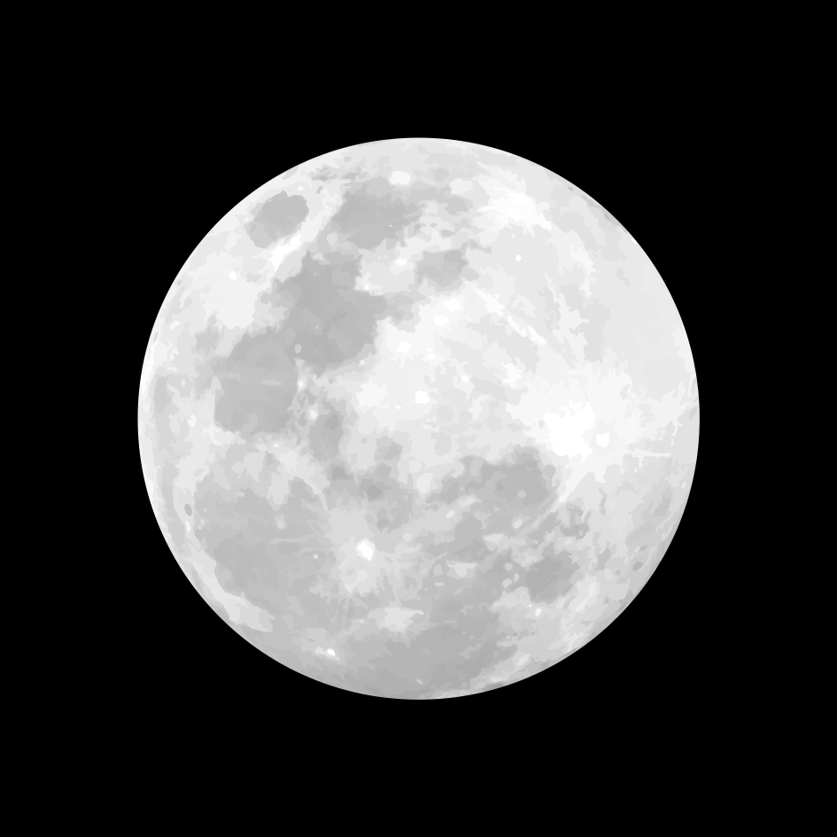
SIH1519-Generation of Hazard map at 1m grid spacing using 5m spatial resolution data for safely navigating a Lander to a safe landing site using Super resolution techniques
ORION SPACE SYSTEMS :
KISHORE R
AARICK YADHUVIR A
SAKETA SRI RAMACHARYULU GUDIMELLA
SUCHI ARORA
SURYA NARAYANAN S
: THARUN A

Slide 2
Abstract
Our solution approach is to use the provided datasets which includes TMC and LROC NAC othrographic and DTM images to analyze the slope, crater depths, heights, distribution, and shadows of the lunar surface in order to create a combined hazard map. Addtionally we are going to super resolve the TMC images from 5m to 1m scale and the NAC images from 0.5m to 1m scale in order to bring them both on the same level for comparison. ( we are using Apollo 12 datasets)
Then we will compare the two different hazard maps of the enhanced images and non – enhanced images to understand the difference.
To successfully identify the craters, shadows and slopes masks in the given image file, we are training the model with more than 2000 images so that it can precisely give us the data.

Slide 3
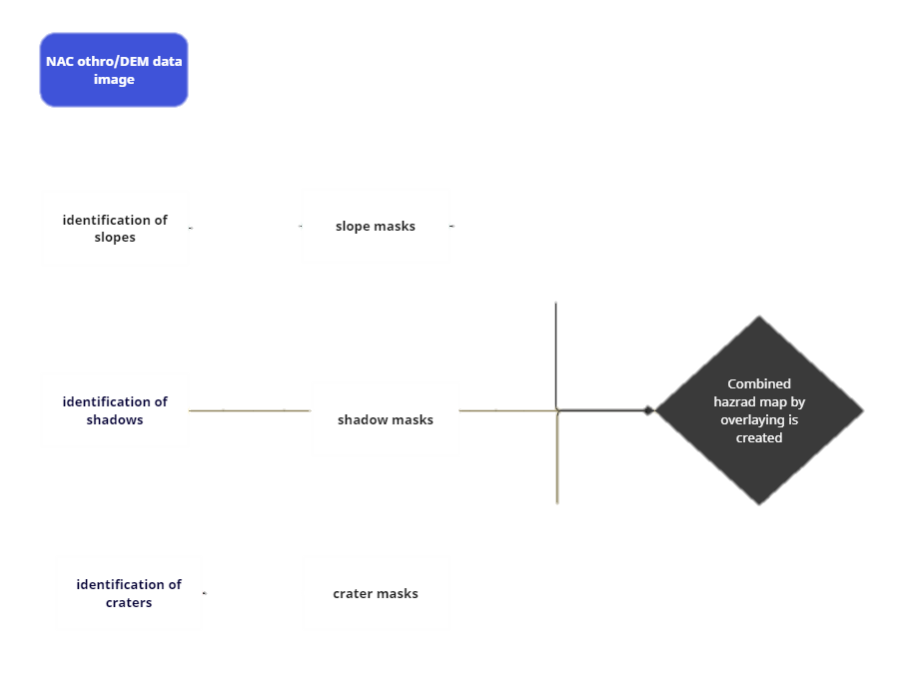
Images are super resolved from 0.5m to 1m
NAC data image flowchart

Slide 4
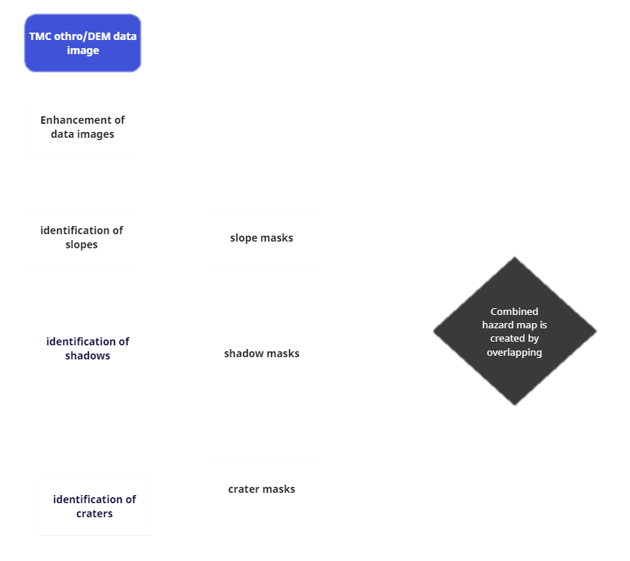
Flowchart of TMC data images
Super resolved from 5m to 1m

Slide 5
Slope masks of NAC images

Slide 6
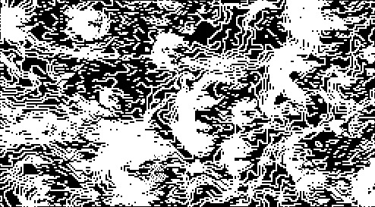
Slope masks of TMC images

Slide 7
Shadow masks of NAC images

Slide 8
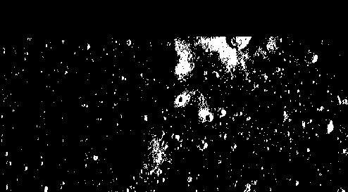
Shadow masks of TMC images

Slide 9
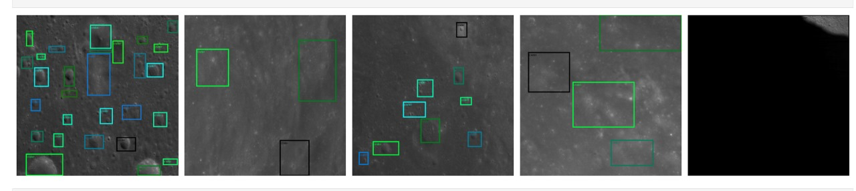
Craters of NAC images
We have trained our own model for accurately identifying the craters present in the images dataset.

Slide 10
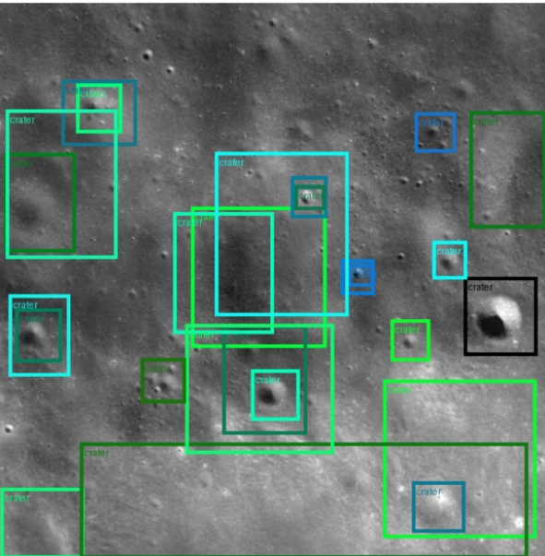
Craters of TMC images

Slide 11
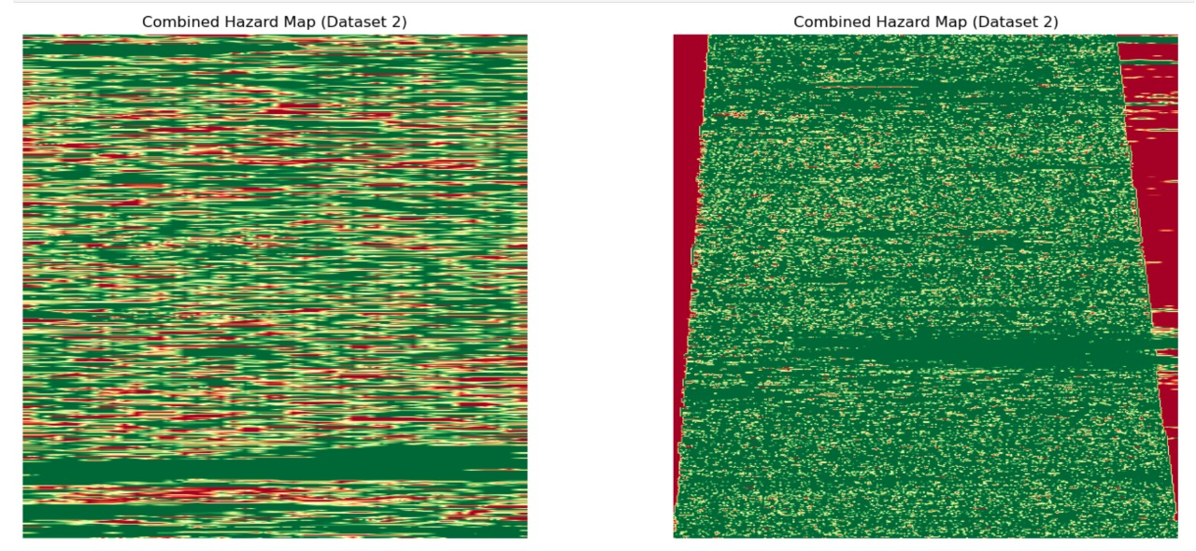
Comparison of hazard maps
Hazard map for NAC (both ortho and DEM)
Hazard map for TMC (both ortho and DEM)

Slide 12
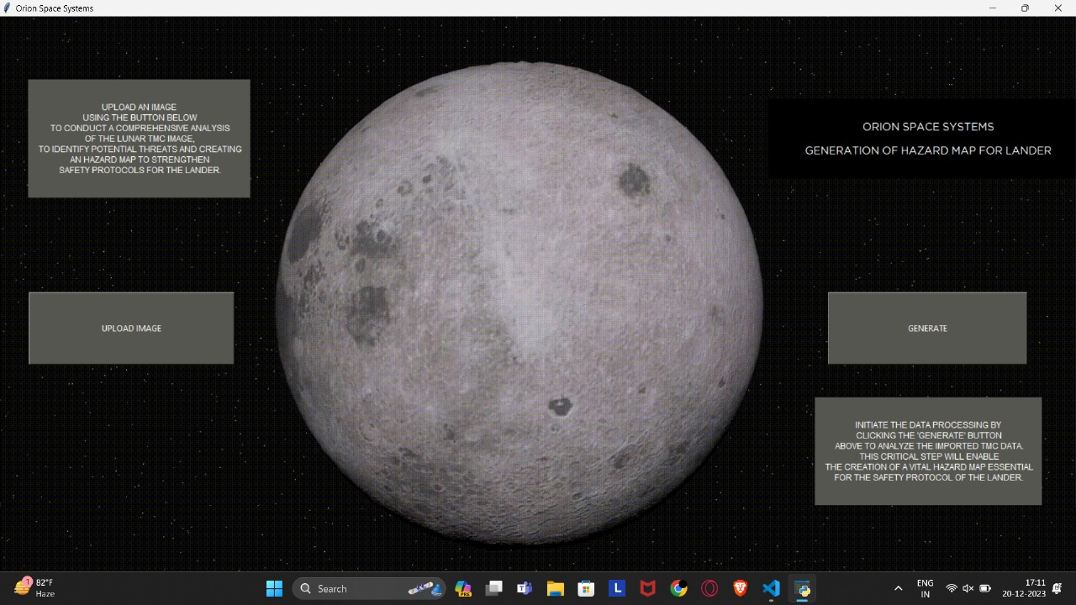
User Interface

Slide 13
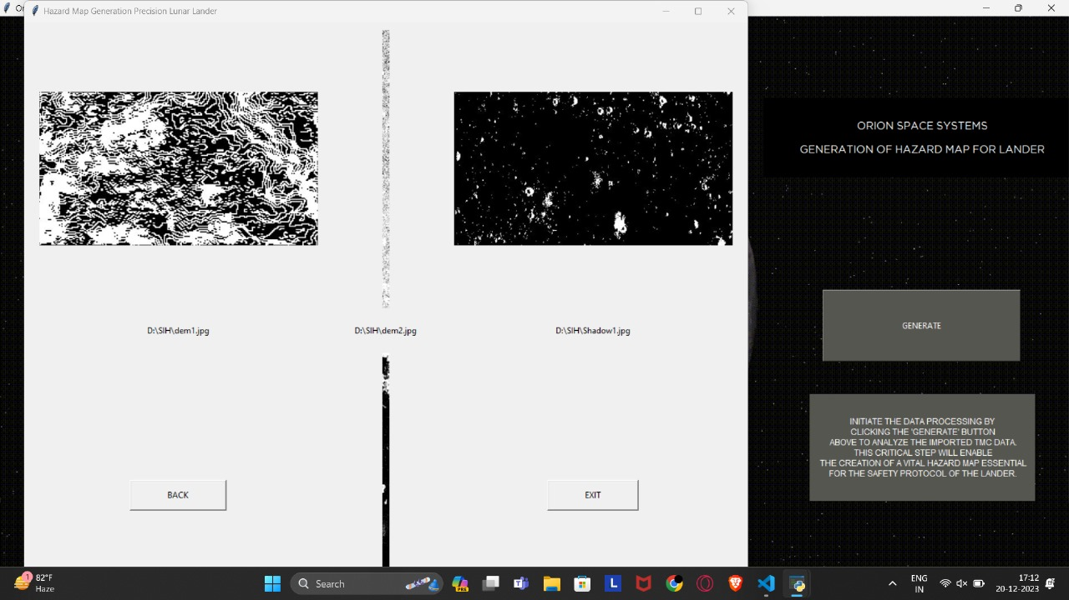
Output from the UI

Slide 14
Thank you for the amazing opportunity to widen our knowledge! As Vikram Sarabhai rightly said-” with adequate support, confrontation at the right time pays off” We aim to continue to pursue and develop this model further.

